Slide 1

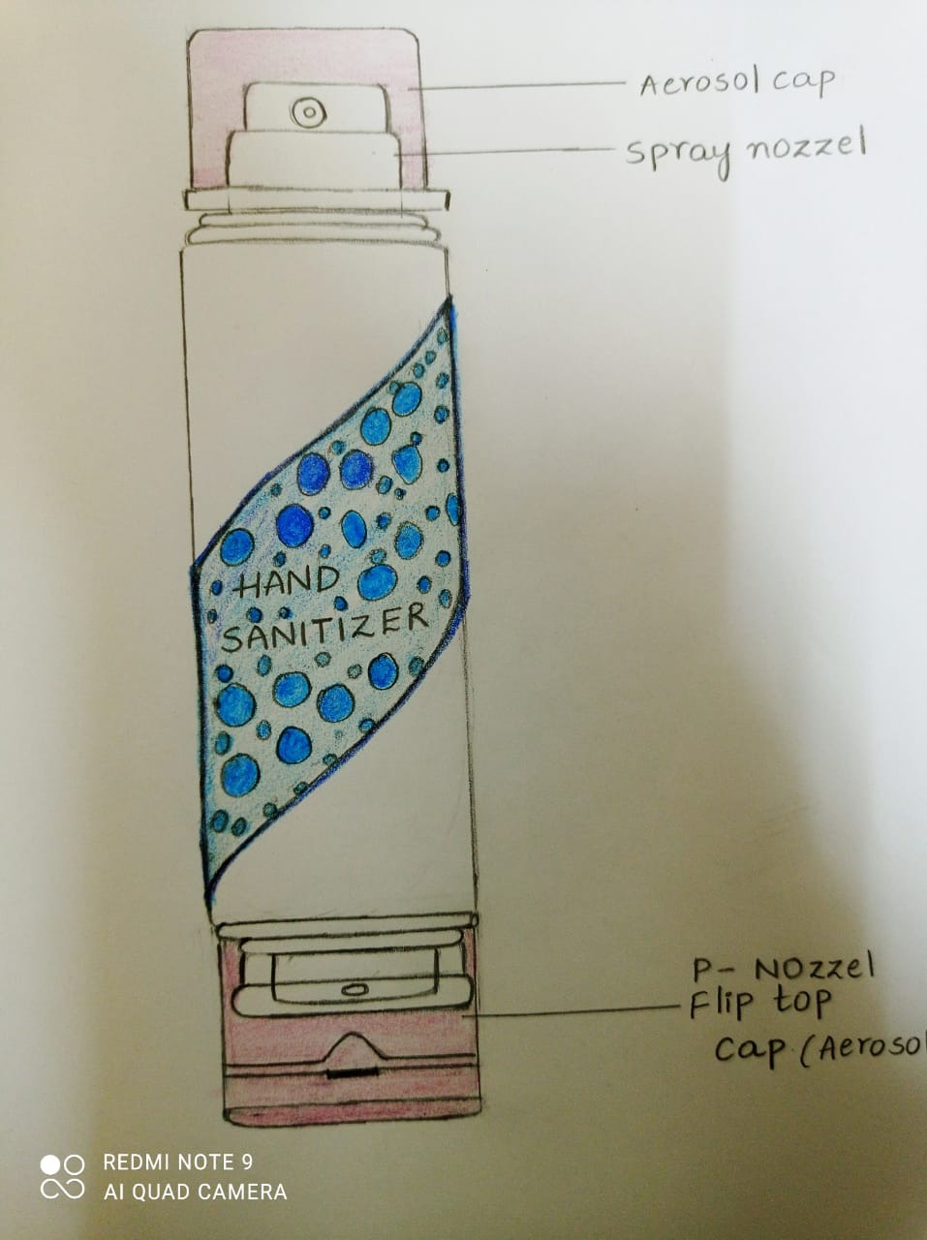
2-WAY SANITIZER BOTTLE
College Logo
Year - I/II
Section - F1
Batch - 07
Group - 07
Team members:
NAME ROLLNO
SABA TABASSUM :2003A51100 DEEPIKA: 2005A41143 AKHIL TEJA :2005A41119 DEEKSHITH :2003A51107
Product Image /Sketch

Slide 2
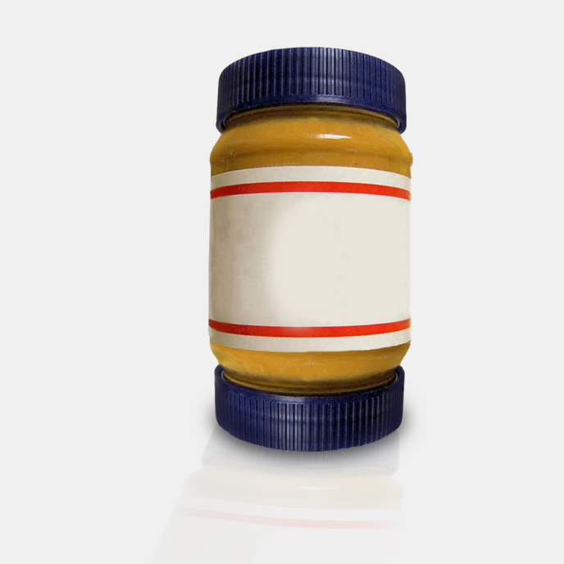
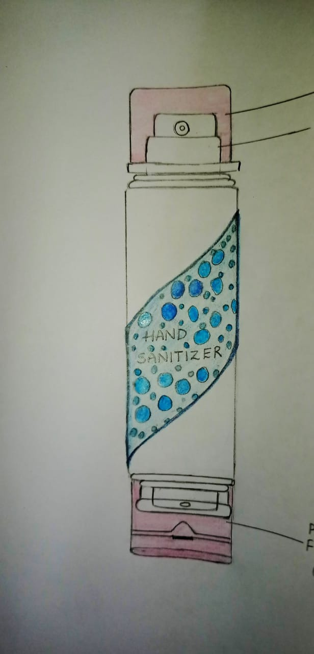
Domain/ Design Space
2-way sanitizer consists of 2 openings one side is a spray sanitizer and other side is a normal opening sanitizer with flip top cap .
In simple , 2 opening sanitizer in one simple bottle. As it will be easy for the people to carry one single product rather than carrying 2 different sanitizer bottles.
Easy and quick to use.
Portable and convenient.
DESIGN SPACE: 2-WAY SANITIZER
RESEARCH GAP: HYGIENE SECTOR OR COVID-19 CONTEXT
From:

Slide 3
Ethnographic Study/Observations
Pains
Sanitizer bottle should not be used near stoves.
The chemicals can make bottle corrosive.
Use of plastic
Effects biodiversity
Gains
Easy to disinfect things without being touched.
2 different needs are fulfilled in one single product.
easy and portable.
pocket friendly product.

Slide 4
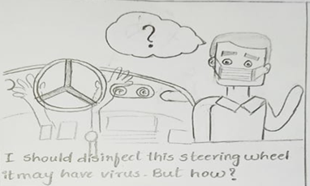
Problem Statement
Statement
1, Covid-19 made all to use sanitizers these days. Disinfecting things before using is must and to be careful before touching anything.
2. Sanitizer interaction with kitchen environment may be dangerous, especially near stove.
Sketches or Photos showcasing the problem /Problems

Slide 5
Need Statement
PEOPLE need a way to protect their HEALTH and be good in HYGIENE and to stay away from virus, germs by sanitizing themselves with sanitizer bottle.
So that they can stop spread of virus, they can sanitize things by using the product and can stay safe.

Slide 6
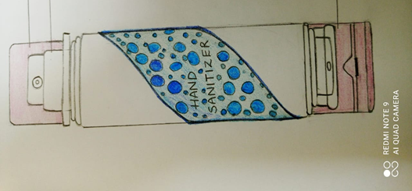
Exploration/ Prior Art Search
From a two way jar to two way sanitizer.

Slide 7
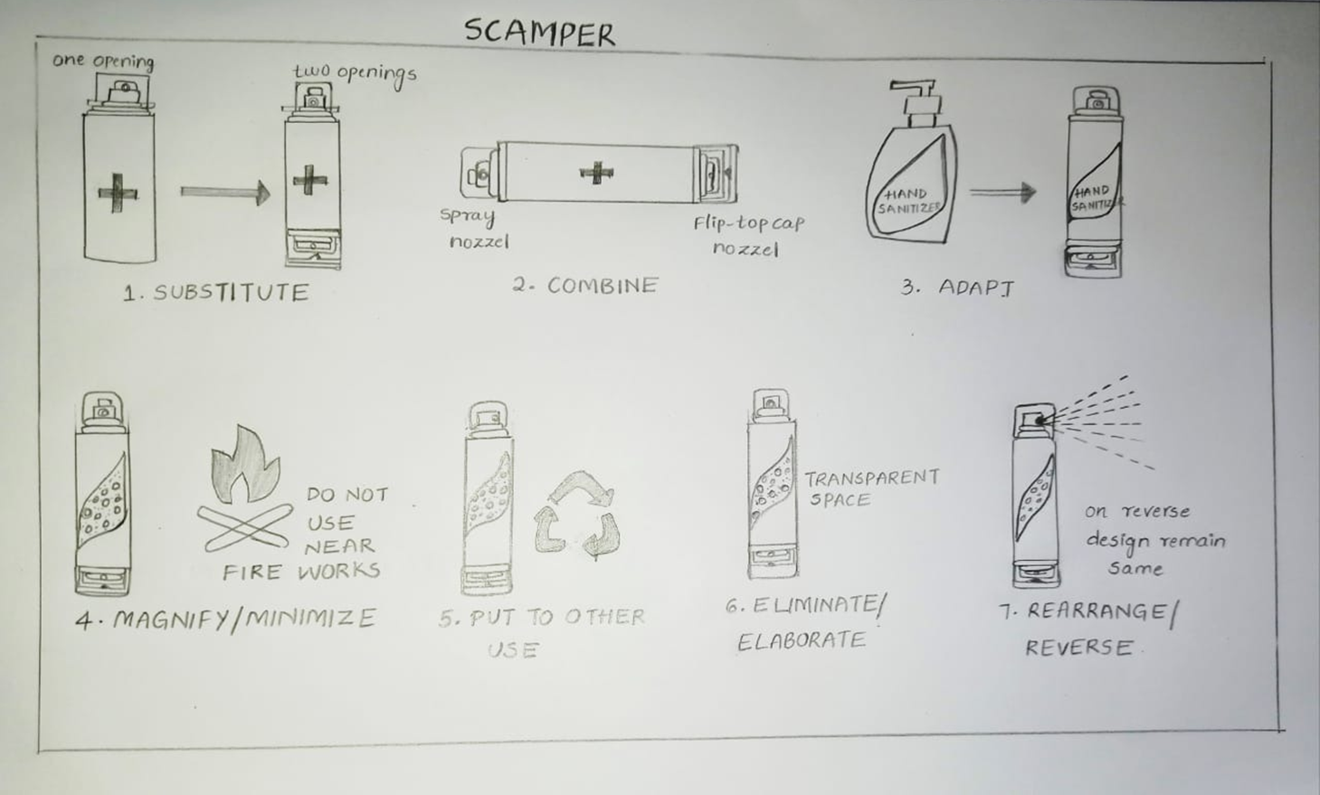
Concepts Generated using SCAMPER
Sketches of Concept 1

Slide 8
Concepts Generated using SCAMPER
Sketches of Concept 2
Concept 2
1.SUBSTITUTE
Substituting one opening for sanitizer with two openings (circular with rectangular).
Benefits:
It is portable and quick to use . Easy to disinfect things.

Slide 9
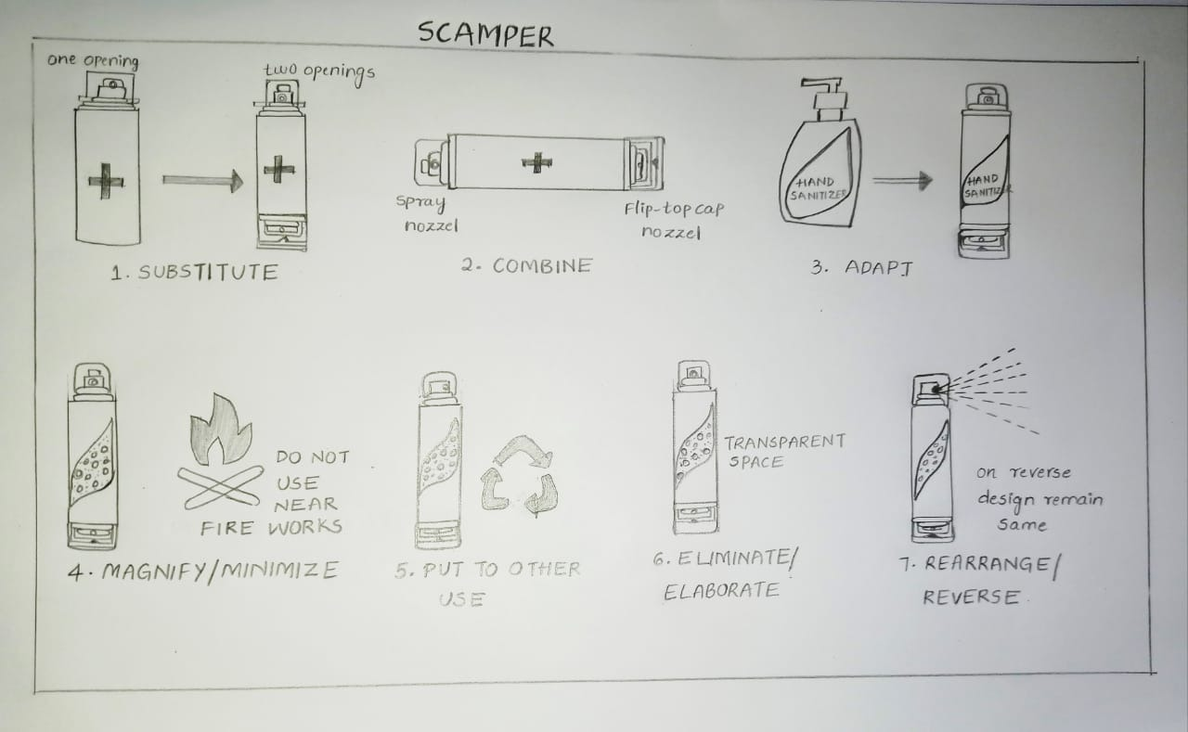
Concepts Generated using SCAMPER
Sketches of Concept 3
Concept 3
2.COMBINE
Combining with spray nozzle and flip top cap nozzle.
Benefits:
Spray nozzle helps to disinfect things without being touched.

Slide 10
Concepts Generated using SCAMPER
Sketches of Concept 4
Concept 4
3.ADOPT
We can change the shape of transparent space to look more attractive.
Benefits:
As it is pocket friendly it attracts the users to grab the product.

Slide 11
Concept Selection
Explain How amd why the Concept X is selected.
Parameters
*Feasibility: The product is pocket friendly and portable.
*Usability: Easy and quick to use.
*Reliability:The quality of product is trustworthy and can be refilled after use.

Slide 12
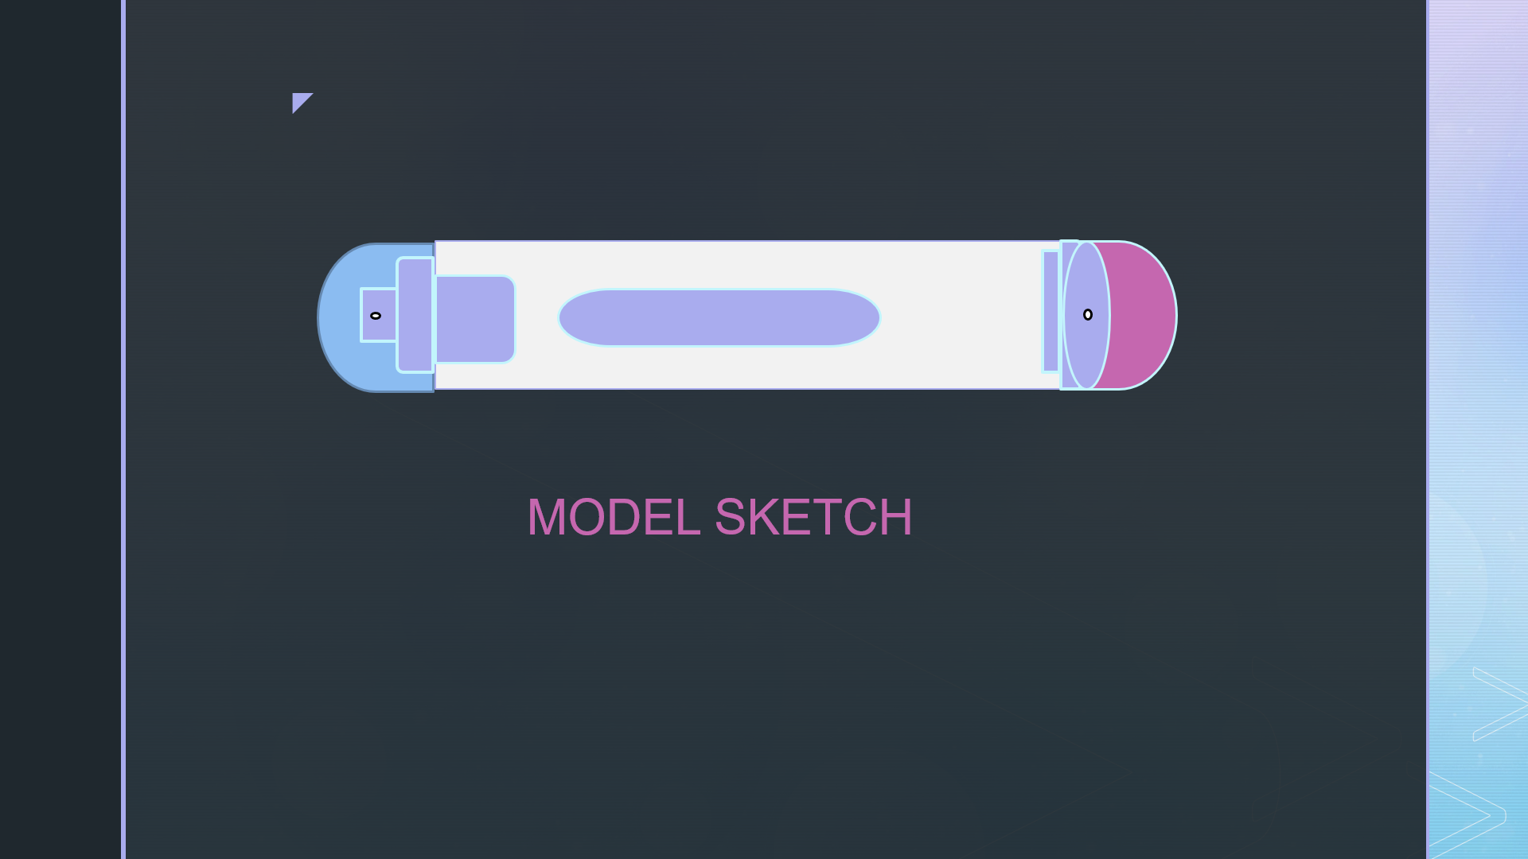
Final Designed concepts with a detailed sketches
3DSketch 1

Slide 13
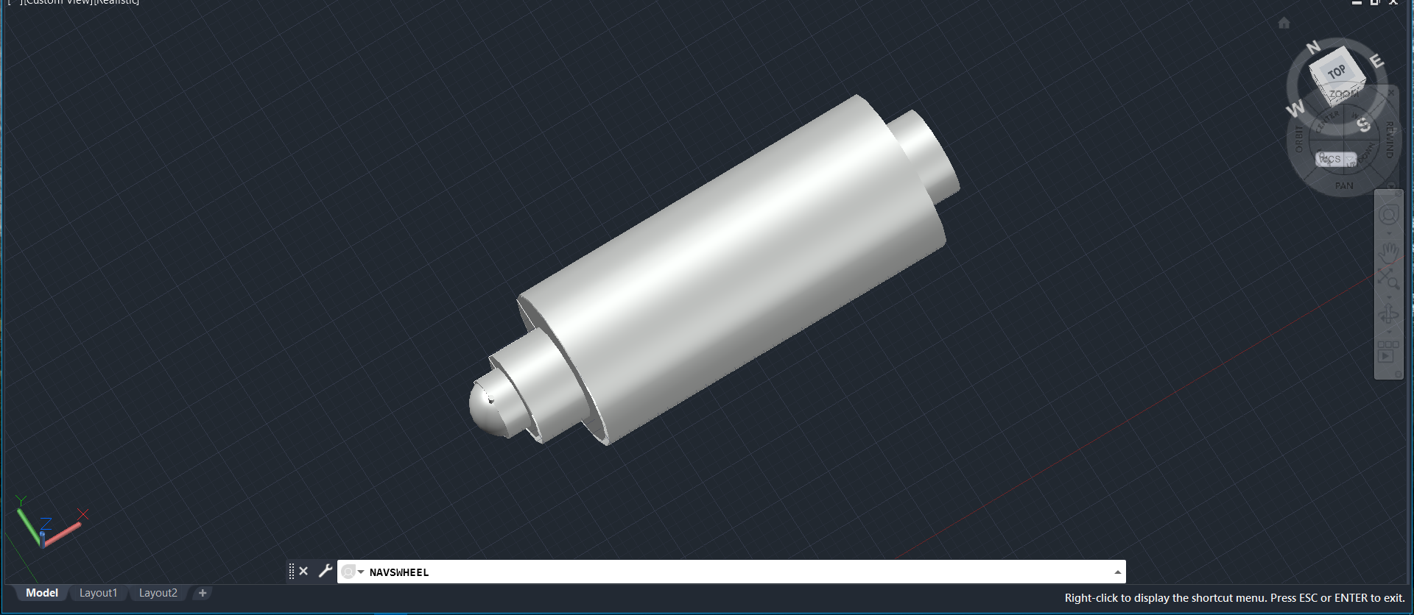
Final Designed concepts with a detailed sketches
Sketch 2: CAD MODEL

Slide 14
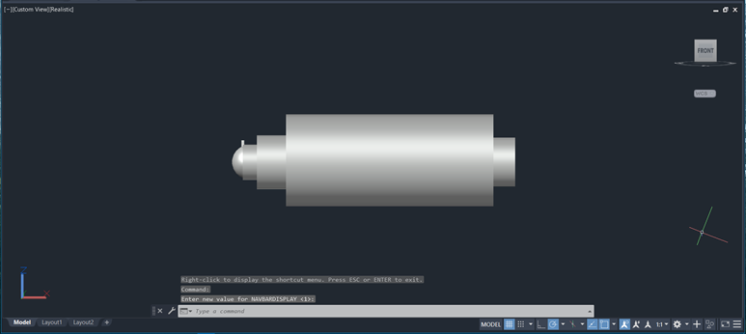
Final Designed concepts with a detailed sketches
Sketch 3: CAD MODEL

Slide 15
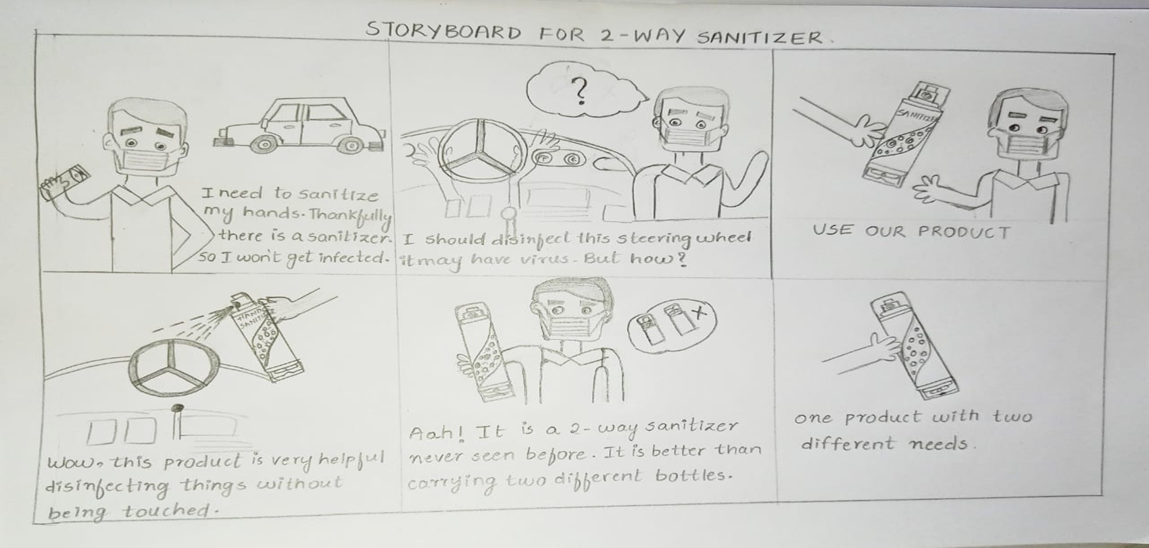
Product Woking Manual - Storytelling
Step 1
Step 2
Step 3
Step 4

Slide 16
Bill of Materials / Future Scope
Approximate Product Cost (along with Individual Materials and production cost-80rs per bottle)
1
2
3
4
6
7
5
ITEM PART | QUANTITY | PART NAME | DESCRIPTION
1 | 2 | Aerosol caps | Plastic.
2 | 1 | Spray nozzle | PP Plastic.
3 | 2 | Outer Gasket | Rubber, LDPE.
4 | 2 | Closure | PP plastic.
5 | 1 | Dip Tube | Plastic.
6 | 1 | Plastic bottle | Plastic.
7 | 1 | Flip top cap | PP Plastic.

Slide 17
Bill of Materials / Future Scope
Future Scope and Improvements
1.We can design the product in other ways, like we can provide space at the back of the bottle to put thermometer into it.
2. It will be useful for the people to carry thermometer with in the product .
3.Portable and quick to use.

Slide 18
Thank You

